Slide 1
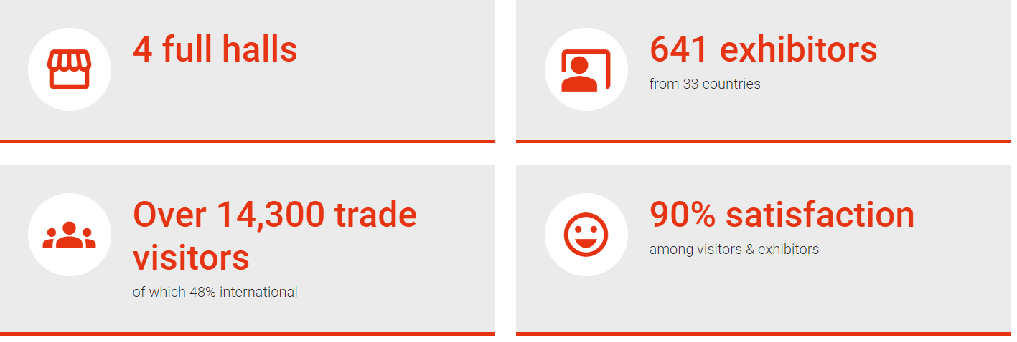

EUROGUSS歐洲壓鑄工業展-2024展後報告
Notes:
https://www.euroguss.de/en/all-about-the-exhibition/impressions-review

Slide 2

EUROGUSS歐洲壓鑄工業展-2024展後報告
Notes:
https://www.euroguss.de/en/all-about-the-exhibition/impressions-review

Slide 3
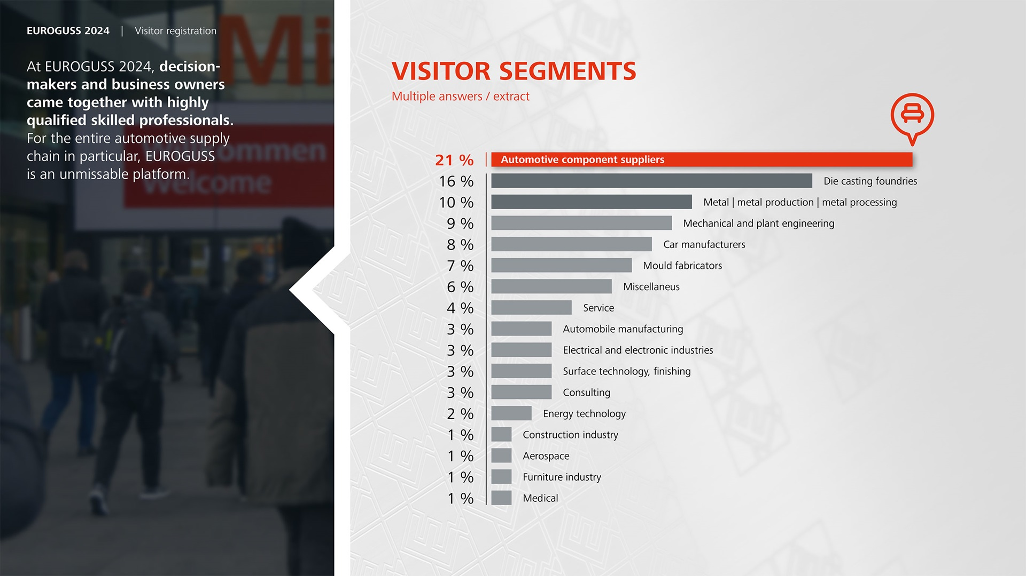
EUROGUSS歐洲壓鑄工業展-2024展後報告
Notes:
https://www.euroguss.de/en/all-about-the-exhibition/impressions-review

